Slide 1
Trigonometry – Labelling sides
EQ: How do we label the triangle sides for working with Trig Ratios?

Slide 2
24
7
30
Trigonometry
Date:
EQ: How do we label the triangle sides for working with Trig Ratios?
We can use trigonometry to find missing angles and lengths of triangles.
Trigonometry uses three functions, these are called:
Sine (shortened to Sin and pronounced “sign”)
Cosine (shortened to Cos)
Tangent (shortened to Tan)
How do we find missing sides and angles?

Slide 3
24
7
30
Trigonometry
Date:
EQ: How do we label the triangle sides for working with Trig Ratios?
Labelling the sides
Hypotenuse
What we call the other two sides will change depending on which angle we are working with, for example..
Opposite
ϴ
Adjacent

Slide 4
24
7
30
Trigonometry
Date:
EQ: How do we label the triangle sides for working with Trig Ratios?
Labelling the sides
ϴ
Hypotenuse
What we call the other two sides will change depending on which angle we are working with, for example..
Adjacent
Opposite
Note: we have shifted the position of the angle
so the Adjacent and Opposite sides have changed
Position as well.

Slide 5
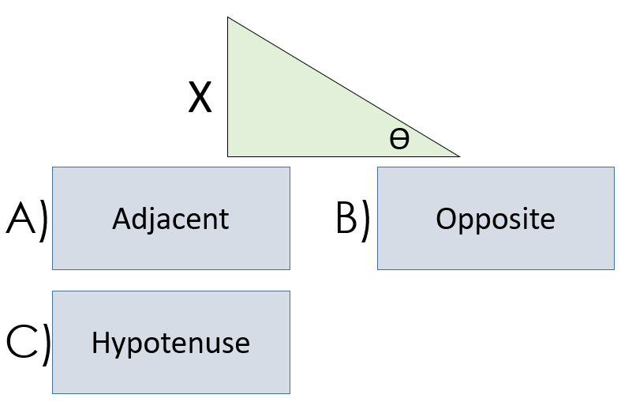
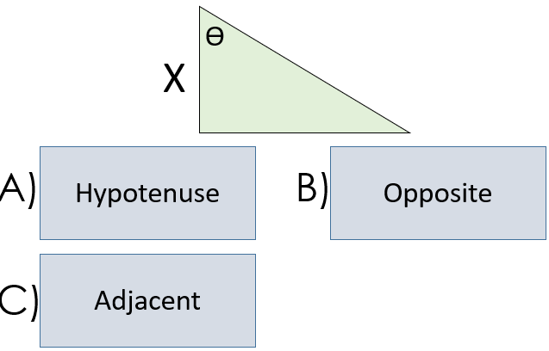
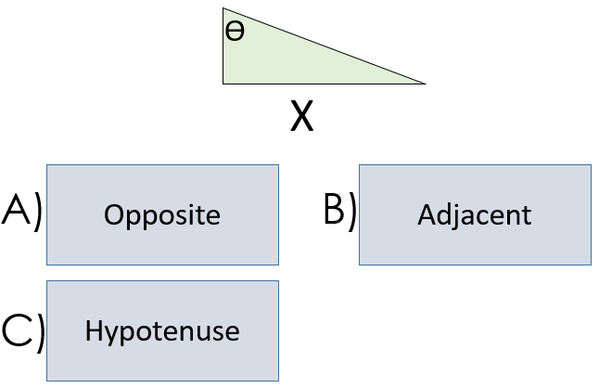
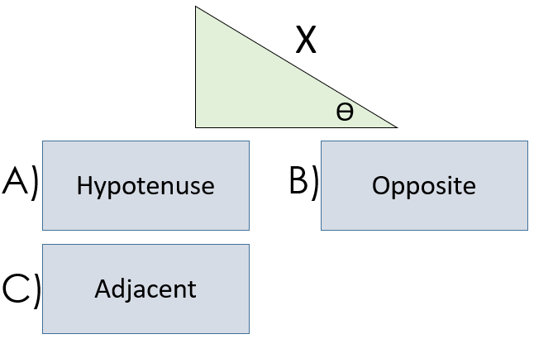
What is the side marked with an X?
1)
2)
3)
4)

Slide 6
What is the side marked with an X?
Answers ✓
1)
2)
✓
✓
3)
4)
✓
✓

Slide 7
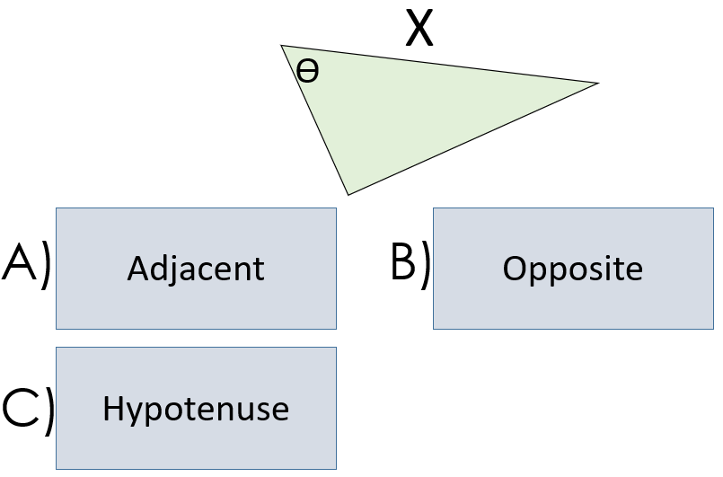
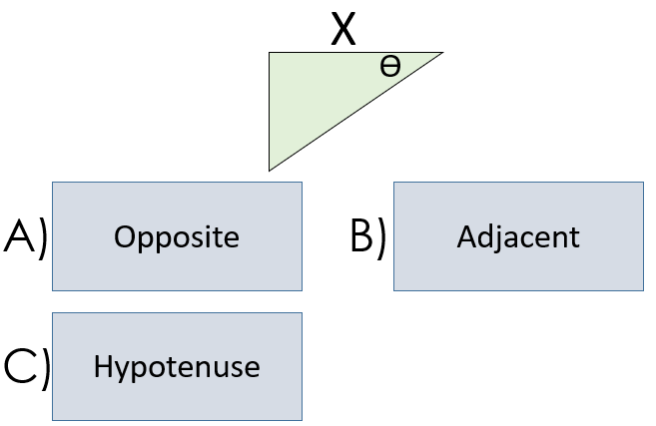
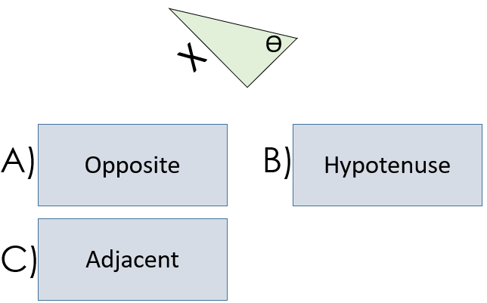
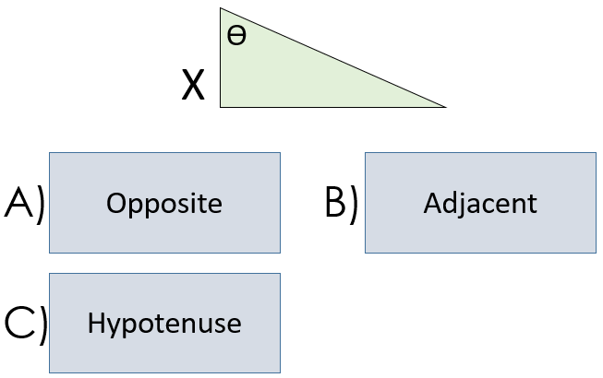
What is the side marked with an X?
5)
6)
7)
8)

Slide 8
What is the side marked with an X?
Answers ✓
5)
6)
✓
✓
7)
8)
✓
✓

Slide 9
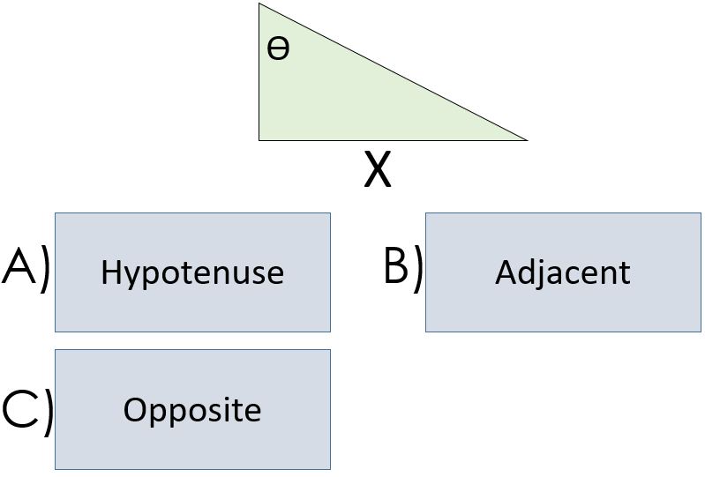
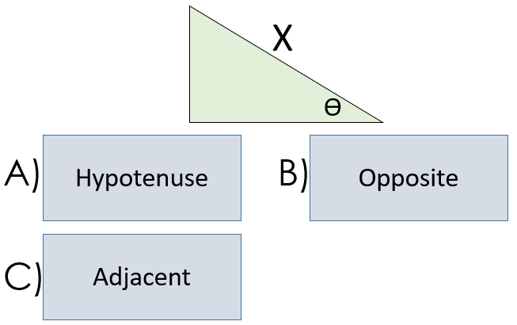
What is the side marked with an X?
9)
10)

Slide 10
What is the side marked with an X?
Answers ✓
9)
10)
✓
✓

